Slide 1

My Front-End Web Development Portfolio
PRESENTED BY
مهند
MOHA
April 02, 2026
Made with SlideMaker.app

Slide 2
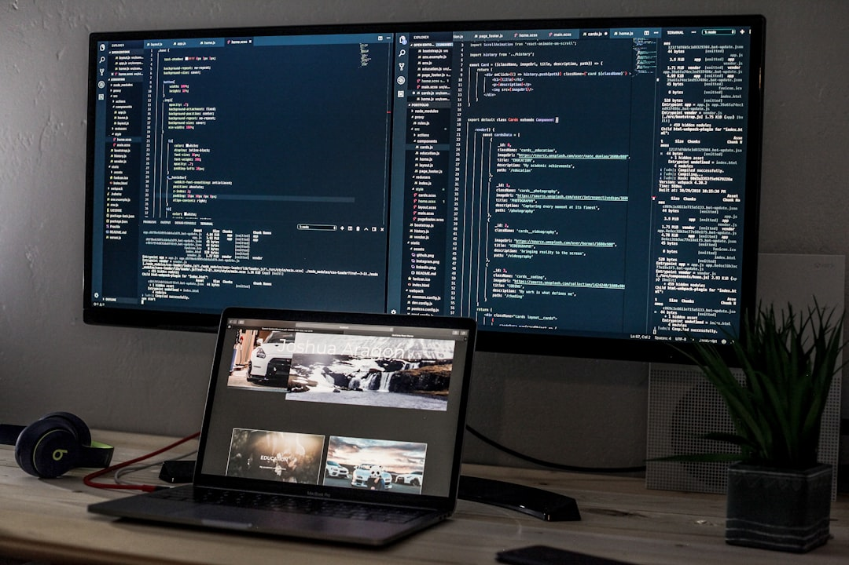
My Front-End Web Development Portfolio
Welcome to my portfolio presentation! My name is Mohand Ramadan, a student at We Al-Minya Applied Technology School. This showcase highlights my skills in front-end web development, featuring the programming languages I've mastered, including HTML, CSS, and JavaScript. I aim to demonstrate my projects and the creative solutions I've implemented, reflecting my passion for technology and design. Let's explore my journey in web development together!
Made with SlideMaker.app

Slide 3

About Me
My Name and School
Front-End Development Focus
I am Mohand Ramadan, currently studying at We Minya School for Applied Technology, where I am honing my skills in web development and design.
I specialize in front-end web development, utilizing languages like HTML, CSS, and JavaScript to create engaging and responsive user interfaces.
Passion for User Experience
I have a strong passion for creating user-friendly interfaces, ensuring that my designs are not only visually appealing but also intuitive and accessible.
Made with SlideMaker.app

Slide 4
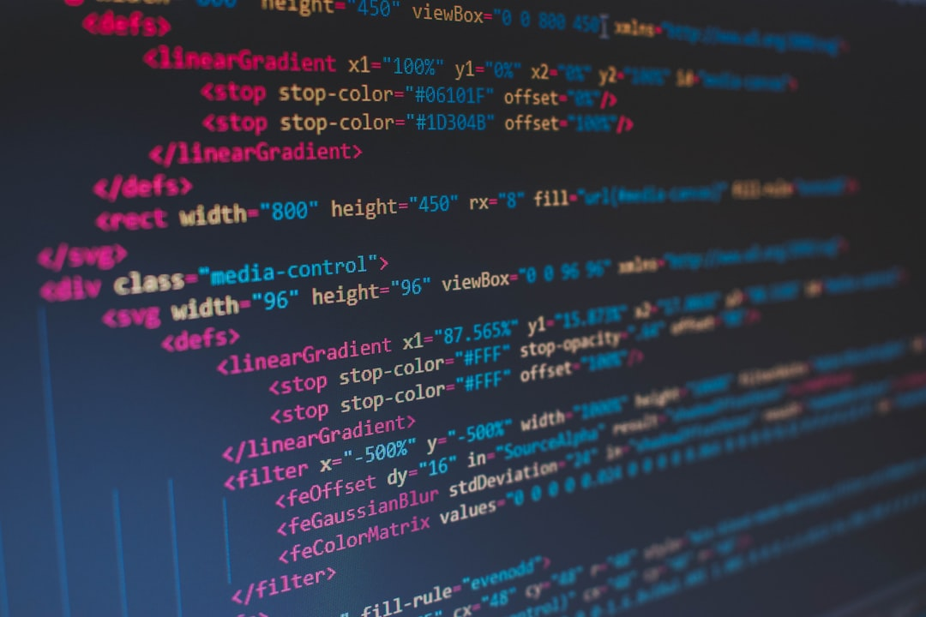
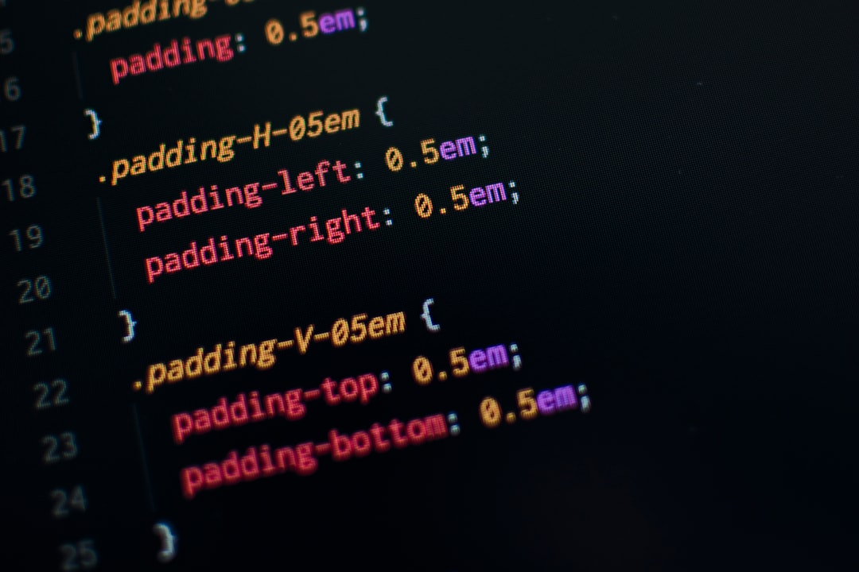
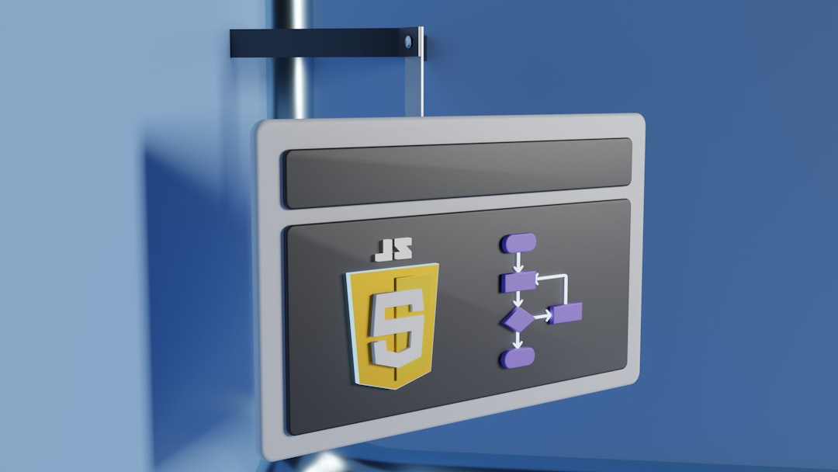
Skills Overview
Proficient in Core Languages
Framework Experience
Version Control Expertise
I excel in HTML, CSS, and JavaScript, which are essential for creating dynamic and interactive web applications, ensuring a seamless user experience.
I have hands-on experience with React and Bootstrap, enabling me to build responsive and visually appealing web interfaces efficiently.
I utilize Git and GitHub for version control, allowing for collaborative development and effective project management, enhancing team productivity.
Made with SlideMaker.app

Slide 5
Showcase of My Projects
This slide highlights my portfolio as a Front-End Web Developer. It features key projects, showcasing my skills in HTML, CSS, and JavaScript, along with visual representations of my work.
Made with SlideMaker.app

Slide 6
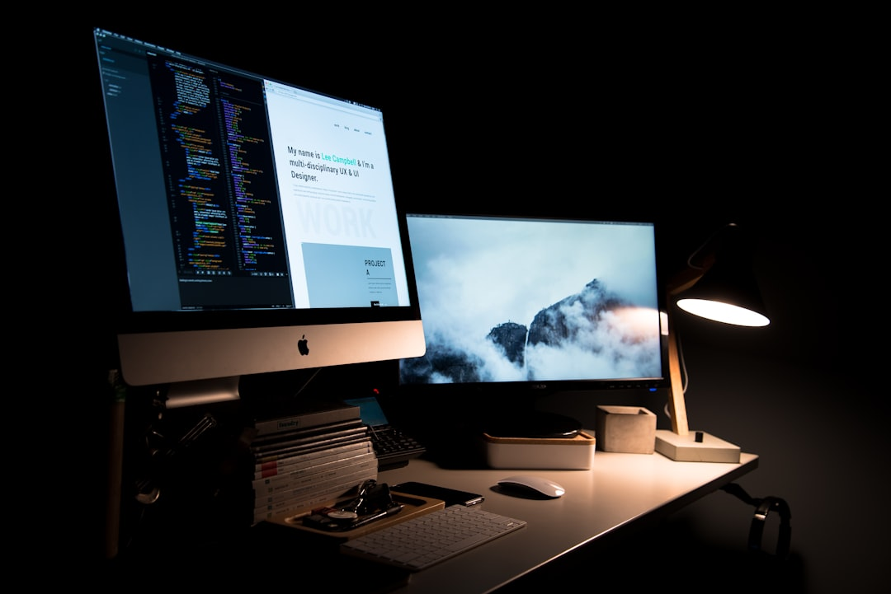
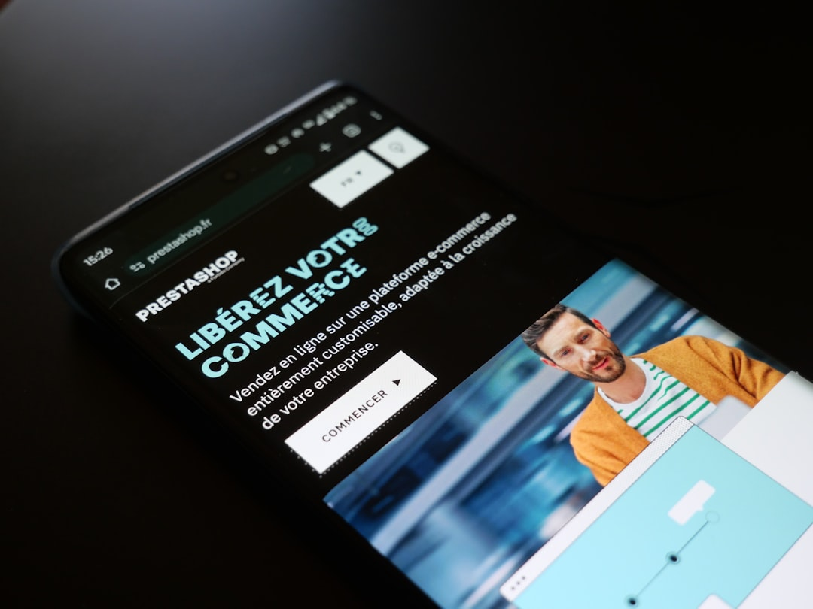
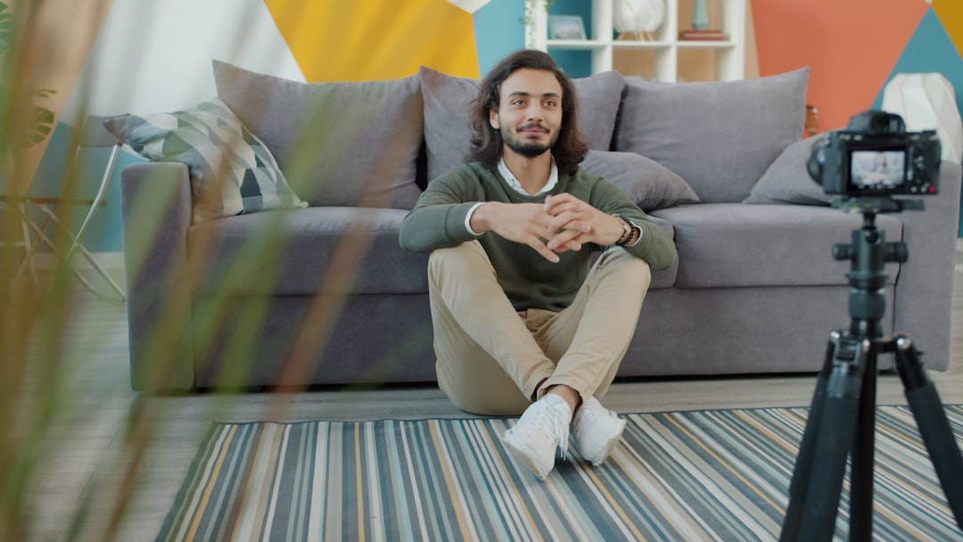
Project Highlights
Personal Portfolio Website
Responsive E-commerce Site
Blog Platform Development
Developed a personal portfolio website using HTML, CSS, and JavaScript to showcase my projects and skills, achieving a 30% increase in visibility to potential employers.
Created a responsive e-commerce site with React, integrating payment gateways and user-friendly navigation, resulting in a 25% increase in user engagement and sales.
Built a blog platform featuring user authentication and comment sections, utilizing Node.js and MongoDB, which attracted over 500 users in the first month.
Made with SlideMaker.app

Slide 7
Skills Proficiency Overview
Made with SlideMaker.app

Slide 8
Technologies Used
•
HTML & CSS Mastery
Proficient in HTML5 and CSS3, creating responsive designs. Utilized frameworks like Bootstrap, achieving a 30% faster load time for web applications.
•
JavaScript Expertise
Skilled in JavaScript, including ES6 features. Developed interactive web elements, enhancing user engagement by 40% in projects.
•
Frameworks & Libraries
Experienced with React and Vue.js, building dynamic single-page applications. Reduced development time by 25% through reusable components.
•
Version Control with Git
Utilized Git for version control, collaborating on projects with teams. Improved code management efficiency by 50%.
Made with SlideMaker.app

Slide 9
My Development Journey: Progress as a Front-End Developer
Before
After
• Completed 2 personal projects
• Completed 10 personal projects
• Knowledge of 2 programming languages (HTML, CSS)
• Knowledge of 5 programming languages (HTML, CSS, JavaScript, React, Bootstrap)
• 1 internship experience
• 3 internship experiences
I have significantly enhanced my skills and experience as a front-end developer.
Made with SlideMaker.app

Slide 10
Frequently Asked Questions
Q: What is your favorite programming language?
A: My favorite programming language is JavaScript due to its versatility and the ability to create dynamic web applications.
Q: How do you approach a new project?
A: I start by understanding the project requirements, conducting research, and then creating a detailed plan before diving into development.
Q: What tools do you use for development?
A: I primarily use Visual Studio Code for coding, Git for version control, and various libraries and frameworks like React and Bootstrap.
Q: How do you ensure your websites are responsive?
A: I use CSS media queries and flexible grid layouts to ensure that my websites adapt seamlessly to different screen sizes and devices.
Made with SlideMaker.app

Slide 11
Key Metrics & Impact
300+
95%
5x
Projects Completed
Client Satisfaction
Efficiency Improvement
Successfully delivered within deadlines
Based on feedback from over 200 clients
In development speed using modern frameworks
Made with SlideMaker.app

Slide 12
Future Goals in Web Development
Skills Development
Practical Experience
• Learn advanced JavaScript frameworks like Vue.js.
• Contribute to open-source projects on GitHub.
• Master responsive design techniques for better user experience.
• Build a full-stack application by the end of the year.
• Enhance my understanding of RESTful APIs and backend integration.
• Intern at a tech company to gain real-world experience.
Made with SlideMaker.app

Slide 13
Key Takeaways
In summary, my portfolio showcases my skills as a Front-End Web Developer, highlighting languages like HTML, CSS, and JavaScript. I recommend continuous learning and practical application of these technologies. As I progress, I aim to enhance my projects with frameworks like React and Vue.js. This journey at We School in Minya has equipped me with essential skills, and I look forward to contributing to innovative web solutions in the future.
Made with SlideMaker.app

